Slide 1
Introduction to your
AmeriHealth Caritas Delaware Plan

Slide 2

AmeriHealth Caritas Delaware — Who We Are
AmeriHealth Caritas is a well-established company with more than 40 years’ experience.
We are one of the largest managed care organizations in the U.S.
AmeriHealth Caritas operates in 13 states and the District of Columbia.

Slide 3

Member Rights
As an AmeriHealth Caritas Delaware member, you have many rights.
Here are some of them.
You have the right to:
Be treated with respect and dignity.
Know that it’s private when you talk with your doctors and other providers.
Have an illness or treatment explained in a language you can understand.
Change your primary care
provider (PCP).

Slide 4

Member Rights (continued)
You also have the right to:
Make a grievance (complaint) about AmeriHealth Caritas Delaware or the care provided to you, and receive an answer.
Request an appeal if you believe AmeriHealth Caritas Delaware was
wrong in denying, reducing, or stopping
a service or item. If you disagree with
the appeal outcome, you may request
a State Fair Hearing from the state.
Be treated no differently by providers
or by AmeriHealth Caritas Delaware
for exercising your rights.
All of your rights are listed in the
Member Handbook.

Slide 5

Member Responsibilities
AmeriHealth Caritas Delaware needs
your help. Please remember that you
have a responsibility to:
Let us, the Delaware Health and
Social Services (DHSS) Change Center,
and your health care providers know
of any changes that may affect your membership and health care needs. For example, if you move
or change your phone number.
Keep your eligibility information up
to date with DHSS. Find out when
your eligibility will need to be reviewed.
Make sure all your information is
updated so you don’t experience a
gap in your coverage.

Slide 6

Member Responsibilities (continued)
You also have a responsibility to:
Work with us and your health care providers. Follow your health care provider’s instructions about your care.
Treat your health care providers and their staff with respect and dignity.
Talk with your health care provider. Agree on goals for your treatment.
Talk with your health care
provider so you can understand
your health concerns.

Slide 7
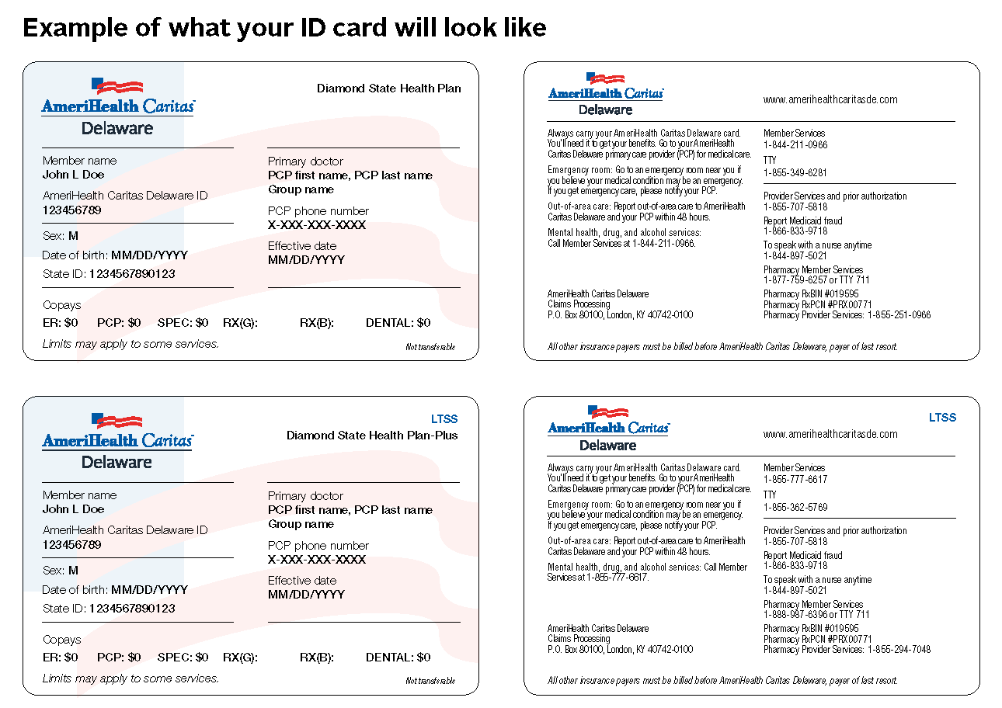
Member ID Card
Be sure to keep your card with you at all times.
You should have it ready to show your provider.

Slide 8

Member Handbook
Member Handbooks are
available upon request:
To request a physical copy
of the Member Handbooks,
contact Member Services.
Member Handbooks are
also available online at www.amerihealthcaritasde.com under the Members tab.

Slide 9

Coordination of Benefits
If you have other medical
insurance, including Medicare:
Show all of your medical
ID cards to all of your health
care providers and pharmacies.
Other medical insurance must
be billed by your provider before AmeriHealth Caritas Delaware is billed.
Let Delaware Health and Social
Services (DHSS) know if you have
other medical insurance coverage
by calling 1-800-372-2022.

Slide 10

What Is Covered?
Some services include:
  Physician services, hospital services, and behavioral health services.
  Preventive screenings.
  Limited dental and vision services.
If you have questions regarding
coverage, please call Member Services:
Diamond State Health Plan
1-844-211-0966
(TTY 1-855-349-6281)
Diamond State Health Plan-Plus
1-855-777-6617
(TTY 1-855-362-5769)

Slide 11
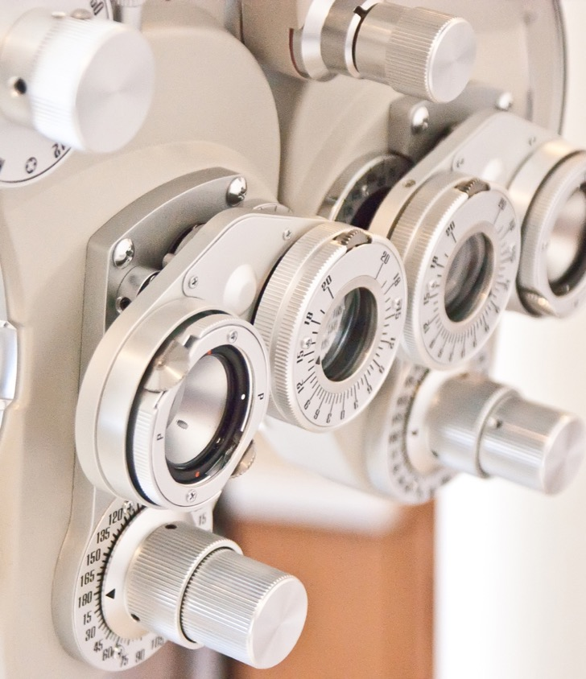
Eye Care
AmeriHealth Caritas Delaware offers vision services for all ages, including:
Routine eye exam once
every 12 months.
One pair of prescription glasses or contact lenses every 12 months.

Slide 12

Dental Services (ages 20 and younger)
Members ages 20 and younger
AmeriHealth Caritas Delaware members ages 20 and younger are enrolled in the Medicaid dental benefit. Services include:
Preventive care: dental cleanings, fluoride, sealants, x-rays.
Restorative care: fillings, crowns.
Braces: No referral needed for first evaluation. Braces are only covered when they meet the criteria for medical necessity.

Slide 13
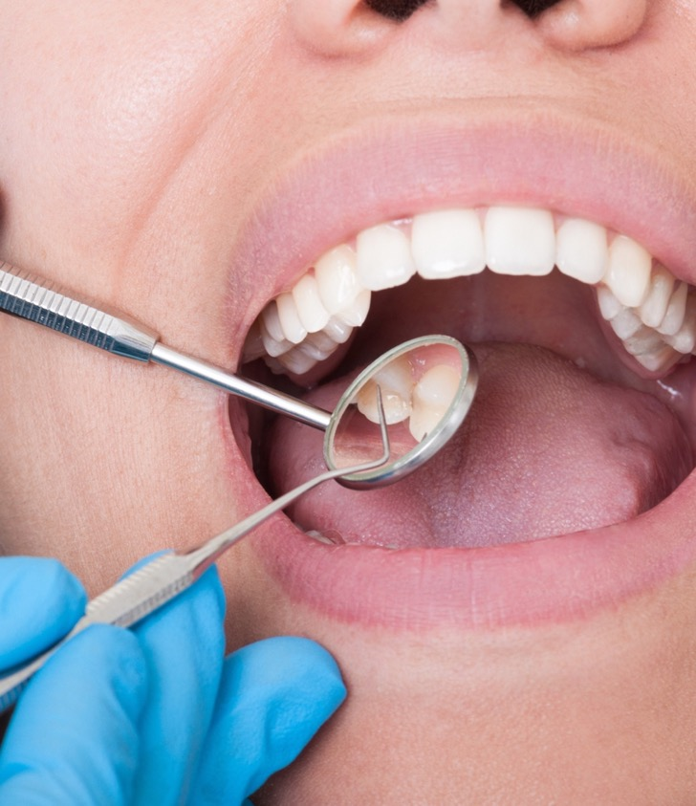
Dental Services (ages 21 and older)
AmeriHealth Caritas Delaware members are enrolled in a Medicaid dental benefit.
The dental benefit includes $1,000 of coverage per year in routine dental services, such as cleanings, X-rays, cavity fillings, and more.
There is no copay for dental visits.
Emergency Dental Benefit
Once you exhaust the $1,000 annual benefit
amount, you may have access up to $1,500 in additional benefits if your clinical needs meet
the emergency benefit criteria.
If you have questions or need help finding
a participating provider, call AmeriHealth
Caritas Delaware Member Services.

Slide 14

Prescription Benefits
AmeriHealth Caritas Delaware
covers medicines that:
Are medically necessary.
Approved by the U.S. Food and
Drug Administration (FDA).
Prescribed by a Delaware
Medicaid Assistance Program
(DMAP) enrolled provider.
If you have questions or need help
finding a participating pharmacy,
call AmeriHealth Caritas Delaware:
Diamond State Health Plan
1-877-759-6257 (TTY 711)
Diamond State Health Plan-Plus
1-855-294-7048 (TTY 711)

Slide 15

Behavioral Health/Substance Use Disorder
AmeriHealth Caritas Delaware members have access to Behavioral Health and Substance Use Disorder (SUD) services:
Covered for all members ages 18
and older.
Children (ages 17 and younger):
30 outpatient visits per year; visits above 30 are provided through the Department of Services for Children, Youth, and Their Families (DSCYF).
Members can find mental health and substance use disorder providers by
calling Member Services.

Slide 16

Long-Term Services and Supports (LTSS)
LTSS are person-centered services
for AmeriHealth Caritas Delaware members approved for DSHP-Plus LTSS.
We support basic activities of daily
life and self-care at home, in the community, in assisted living, and
in nursing homes.
At AmeriHealth Caritas Delaware,
we, along with you and your
caregivers, develop a service plan
based on your assessed needs.
Health and safety are very
important. We proactively address
risks to enable you to live as independently as possible.

Slide 17

Non-Emergency Transportation
You can call ModivCare at 1-866-412-3778
to see if you qualify for transportation to medical appointments.
Where’s My Ride? Hotline: 1-866-896-7211
Remember:
Call at least three days in advance
to schedule an appointment.
You will need to have the
address, including city and ZIP code,
of the appointment.
You will need to have your
Medicaid member ID Number.
This service is not available for Delaware Healthy Children Program members.

Slide 18
Additional Benefits
AmeriHealth Caritas Delaware members can receive extra benefits at no extra cost.
These services include:
24-hour member services line.
Lamaze® classes.
24/7 Nurse Call Line. (Nurse Advice Line)
Pediatric care management.
Immunization reminders.
Mammogram scheduling.
Parenting classes.
Supportive disease management.
Community events.
Health education.
Do Care Doula.
Weight Watchers
Telehealth

Slide 19
About Managed Care

Slide 20

What Is a Primary Care Provider (PCP)?
A PCP can be a doctor, nurse, nurse practitioner, or nurse midwife, or a licensed physician such as a family or general practitioner, geriatrician, pediatrician, OB/GYN, or internist who plans and/or helps you access health care services.
A PCP is someone you should visit
at least once a year, in addition to
visiting them if additional health concerns arise.
Your PCP knows your health history
and can help you get needed medical services like specialist care, hospitalizations, labs, and X-rays.
You can change your PCP by
contacting Member Services.

Slide 21

What Is Specialty Care?
Specialty care is given by a doctor
who has received extra medical training. For example, a doctor can specialize in the heart (cardiologist), bone or muscles (orthopedist), or brain (neurologist).
If you have health needs that require specialized care, your PCP may send
you to a specialist.
AmeriHealth Caritas Delaware covers your visits to specialists in our network. You do not need a referral to see a network-participating specialist.

Slide 22
Emergency Versus Urgent Care
Emergency care | Urgent care
An emergency condition is a problem so serious that you must seek care right away to avoid severe harm. | Treatment of a condition that is potentially harmful to a patient’s health and is medically necessary to receive treatment within 48 hours to prevent deterioration.
Call your PCP or behavioral health specialist first. If they cannot be reached, call the AmeriHealth Caritas Delaware 24/7 Nurse Call Line at 1-844-897-5021 if you are not sure if it’s an emergency. | Call your PCP or behavioral health specialist first. If they cannot be reached, call the AmeriHealth Caritas Delaware 24/7 Nurse Call Line at 1-844-897-5021. The PCP must schedule an appointment within two calendar days of the request for an urgent care appointment.
If you go to the emergency room, call your PCP for a follow-up appointment the next day. | If you go to an urgent care center, call your PCP for a follow-up appointment the next day.

Slide 23
Examples of Emergency Versus Urgent Care
Examples of emergencies | Examples of urgent care needs
Breathing problems | Animal bites
Broken bones | Bruises
Chest pain | Colds
Choking | Coughing
Drug overdose | Diarrhea
Loss of speech | Earache
Poisoning | Pinkeye
Severe burns | Rashes
Severe dizzy spells, fainting, or blackouts | Sore throat
Severe spasms or convulsions | Stomachache
Severe wounds or heavy bleeding | Vomiting
Sudden loss of feeling or not able to move | Feeling very depressed or anxious
Strong feelings of wanting to hurt yourself or someone else

Slide 24
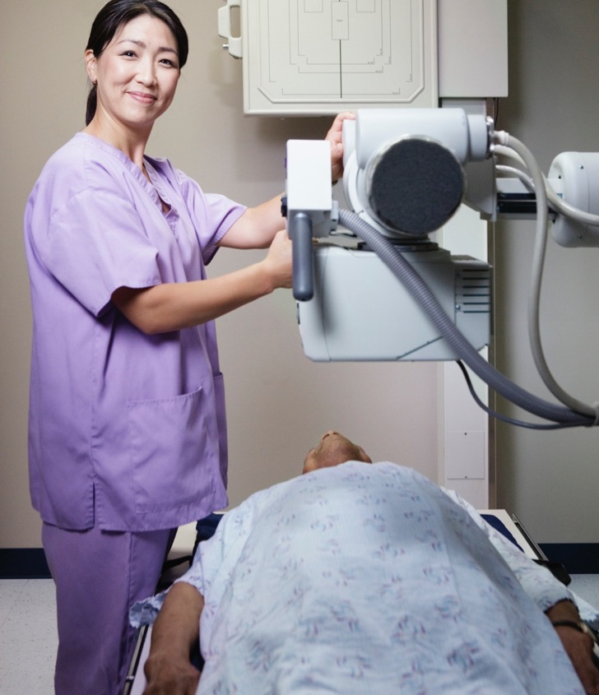
Preventive Screenings
Annual preventive physicals for adults.
Mammograms.
Cervical cancer screenings.
Early and Periodic Screening, Diagnostic, and Treatment (EPSDT).
Well-child care checkups.
Adolescent well care.
Preventive health screenings.
Lead screenings.
Diabetic care (HbA1c screenings).
Adult body mass index (BMI).

Slide 25

Children’s Well Visits — Early and Periodic Screening, Diagnostic, and Treatment
Screenings for children younger
than age 21 include:
Complete physical exam.
Shots (immunizations).
Lab tests (blood tests, lead levels, and urine tests).
Vision and hearing tests.
Dental screening by a PCP.*
Growth measurements.
Tuberculosis (TB) testing.
Blood pressure check.
Health and safety education.
Child health and development history.
Body mass index (BMI) check.
Tracking the child’s development and eating habits.
Behavioral and mental health, social emotional skills.
*A dental screening by a PCP is covered for children younger than age 21 as part of Early and Periodic Screening, Diagnostic, and Treatment.

Slide 26




Care Coordination
AmeriHealth Caritas Delaware provides care coordination for
all members through:
Care Coordinators.
Resource Coordinators.
Health education.
Care Coordinators
Member
Health education
Resource Coordinators

Slide 27
Care Management
24/7 Member Services
Diamond State Health Plan:
1-844-211-0966
Diamond State Health Plan-Plus: 1-855-777-6617
One-to-one care management
Member
care
High-risk maternity
care management
24/7 Nurse Call Line
1-844-897-5021

Slide 28
Value-Added Services

Slide 29
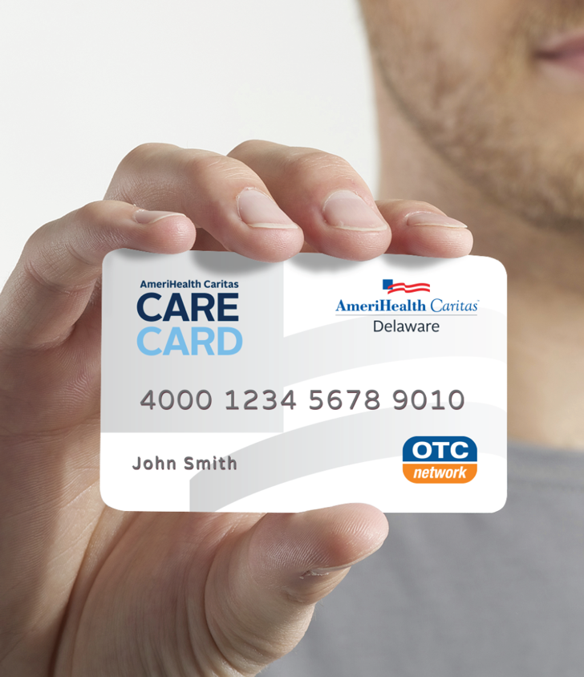
CARE Card
The CARE Card is an incentive program where you can earn rewards by staying healthy.
By completing the new member Health
Risk Assessment (HRA) within the first year of your enrollment, you could earn $25!
You can complete your HRA via the paper form sent to you in your New Member Welcome Kit; by phone; or online at amerihealthcaritasde.com/HRA.
For more information, visit amerihealthcaritasde.com/carecard.

Slide 30
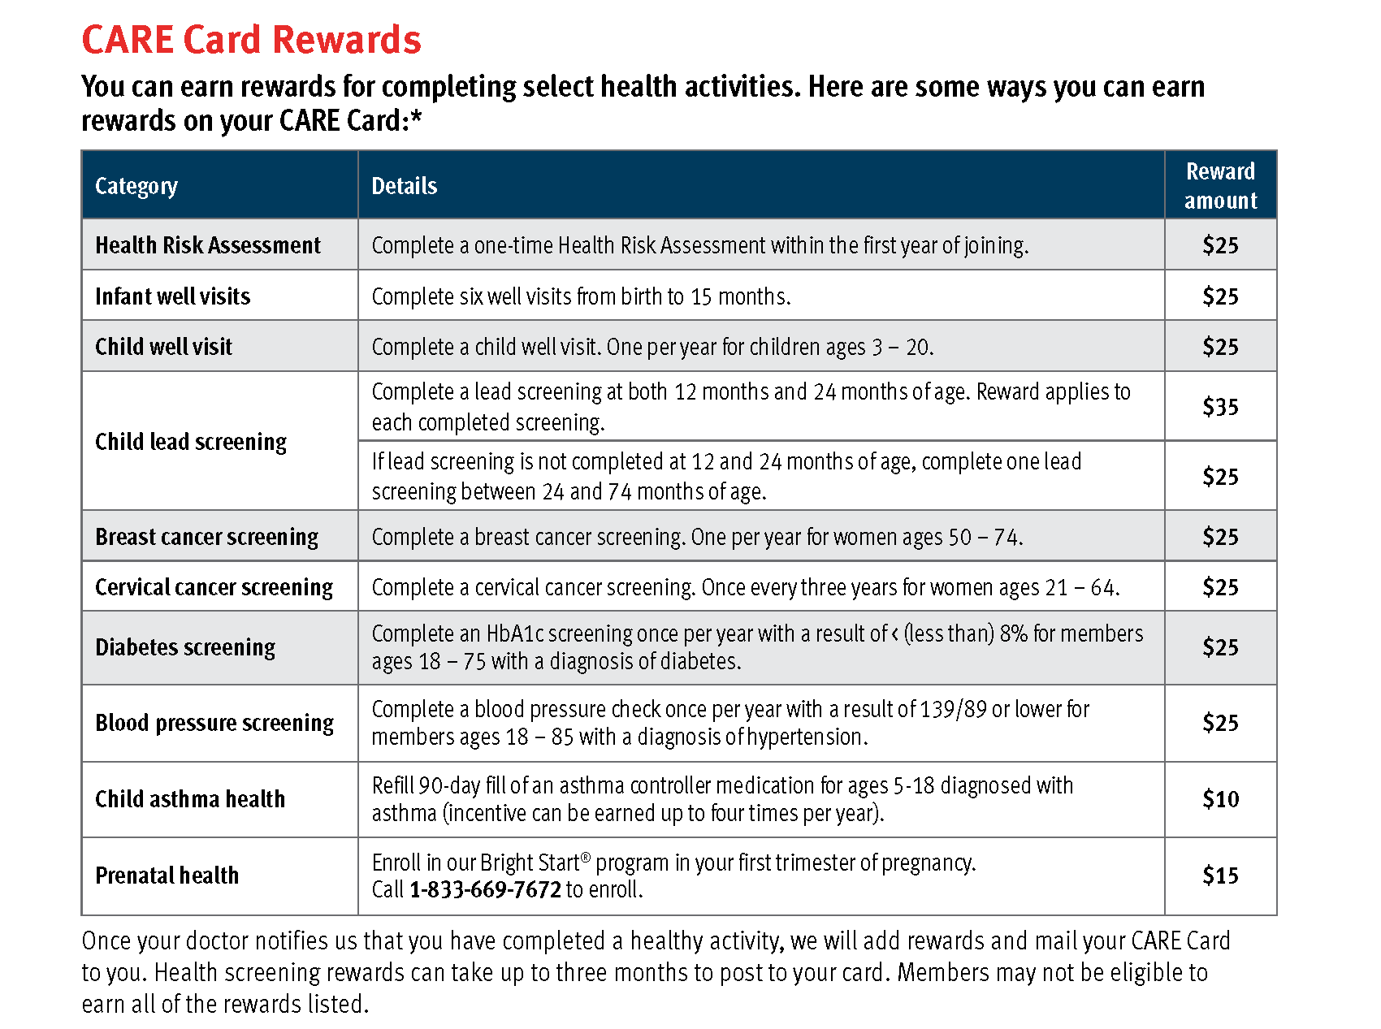
CARE Card (cont.)

Slide 31


Prenatal Care
Bright Start® is AmeriHealth Caritas
Delaware’s maternity management program.
The Bright Start program helps members
have the healthiest pregnancies possible.
Bright Start can:
Help members select the right
providers for their prenatal care.
Help members arrange prenatal
and postpartum visits.
Provide members with Bright Start
Care Managers.
Help members get food for their
babies through the Special Supplemental Nutrition Program for Women, Infants,
and Children (WIC).

Slide 32

Prenatal Care (continued)
Bright Start can provide members
with extra help if they:
Have a history of diabetes,
asthma, or depression.
Have developed high blood pressure.
Have had a preterm delivery in the past.
Struggle with drug or alcohol use.
A Bright Start specialist is available
to members Monday through Friday,
from 8 a.m. – 5 p.m.

Slide 33

General Educational Development (GED®)
Have you wanted to earn your GED?
AmeriHealth Caritas Delaware
can help with:
Expenses: AmeriHealth Caritas Delaware will pay for testing fees.
Coaching: Once you enroll in
GED preparation classes, a
program coach will work with
you every step of the way.
What to do next:
Call the Rapid Response and
Outreach Team at 1-844-623-7090,
and ask for more information.

Slide 34


Health Education Programs
Healthy Hoops –
an asthma education program
that focuses on basketball and
healthy activity to manage asthma.
Community Baby Showers –
free prenatal information hosted
by the Bright Start program for
expecting and new mothers.

Slide 35
Member Advisory Committee
Member Advisory Council meetings allow us to hear from you about how to improve our benefits and services.
In these sessions, members, providers, community organizations, and member advocates provide feedback on our benefits and services.
You can discuss any issues with a broader community at the MAC meeting. This is your chance to comment on how well we are doing. You are welcome to voice any questions or concerns you may have regarding the delivery of services. Collectively, we share ideas and discuss ways to improve:
Value-added benefits, such as vision and obtaining your GED
Member materials for better understanding
Connecting members to community resources

Slide 36
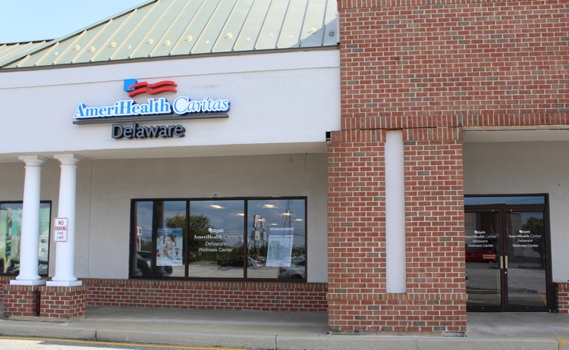
Wellness Center
The AmeriHealth Caritas Delaware Community Wellness Center is a hub for health and wellness resources and activities in your community.
It is open to everyone, at no cost to you.*
Stop by the community
wellness center for:
Special community events.
Weight management programs, such as yoga, dance, and fitness classes, healthy cooking demonstrations and more.
Free computer access.
Telehealth Appointments
A play area for children under
parental supervision.
A meeting space for
business purposes.
Food pantry.
AmeriHealth Caritas Delaware
Community Wellness Center
1142 Pulaski Highway, Unit 6A
Bear, DE 19701
(Glendale Plaza Shopping Center)

Slide 37
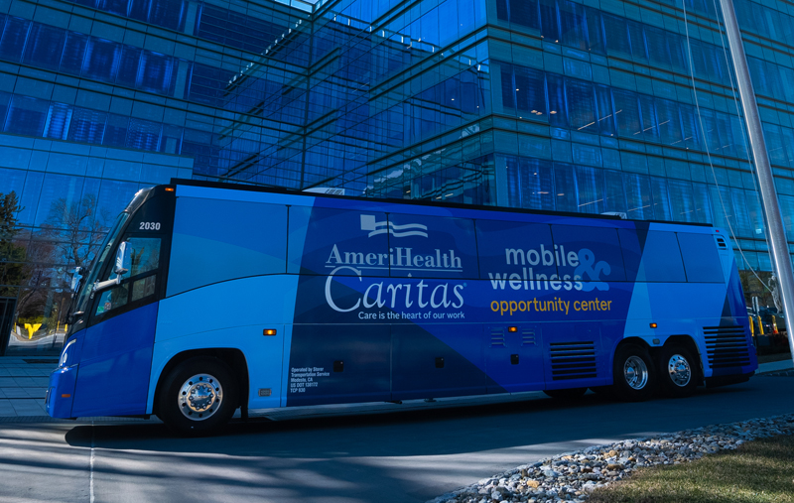
Mobile Wellness & Opportunity Center
Our Mobile Wellness & Opportunity Center is a community hub offering:
Health education and screenings
Healthy food demonstrations and classes
Fitness classes
Job readiness events
Baby showers
Training events
And much more!
To learn more, visit the AmeriHealth Caritas Delaware website.

Slide 38
Important Contacts

Slide 39
Grievances and Appeals
We want you to be happy with AmeriHealth Caritas Delaware and your health care providers. If you have questions or concerns about AmeriHealth Caritas Delaware benefits or services, you can call Member Services. We can help with questions and concerns. If we cannot immediately resolve your questions or concerns, we will investigate the issue and respond within 30 days.
Grievance system*
Depending on the circumstance, members can take the following steps:
Submit a grievance (complaint) to AmeriHealth Caritas Delaware.
Appeal a decision AmeriHealth Caritas Delaware has made to deny or limit services.
Request a State Fair Hearing if you are dissatisfied with an appeal decision by AmeriHealth Caritas Delaware.
* Please refer to your Member Handbook for the complete description of the grievances and appeals process.

Slide 40
Managed Care Ombudsman
For members receiving long-term care services and supports (LTSS), the Delaware Department of Health and Social Services (DHSS) advocates for residents living in
long-term care facilities, as well as those who live at home and receive home- and community-based services.
The Ombudsman investigates and resolves complaints.
Long-Term Care Ombudsman
1-800-223-9074 (TTY 1-302-391-3505)
delawareadrc@state.de.us

Slide 41
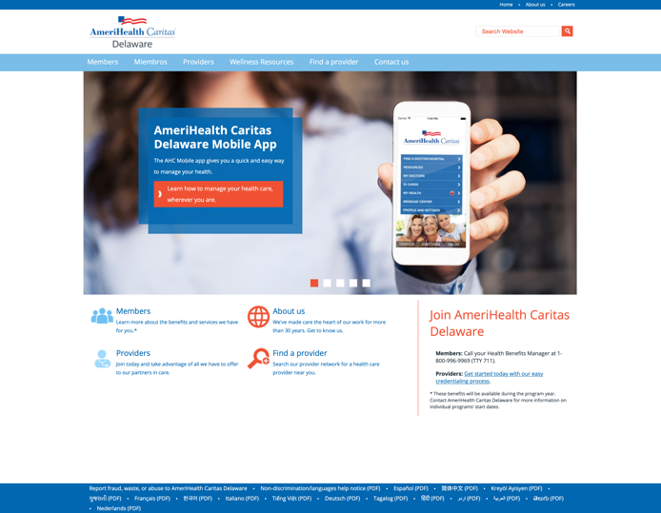
Member Website
Find what you are looking for on our website
at www.amerihealthcaritasde.com. You can
learn more about:
Benefits and services.
Health and wellness programs.
Links to health education.
Community services.
Member resources.
Frequently asked questions.
Contact information.
Health Insurance Portability and Accountability Act (HIPAA) Notice of Privacy Practices.
Member rights and responsibilities.
Grievances, appeals, and State Fair Hearings.
Finding a provider or specialist.

Slide 42
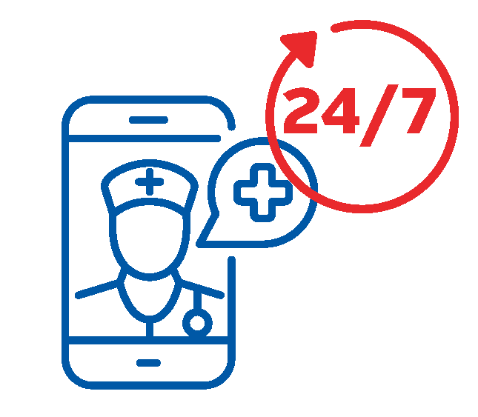

Member Website (continued)
Telehealth Services Education
Telehealth (sometimes called telemedicine) means you can connect with a provider outside of the office.
If your primary care physician’s (PCP’s) office is closed or you’re wary of venturing into a public space, ask if you can:
Video chat with your PCP through
a computer, tablet, or smartphone.
Text with your PCP through
a secure web portal.
Talk to your PCP by phone.

Slide 43
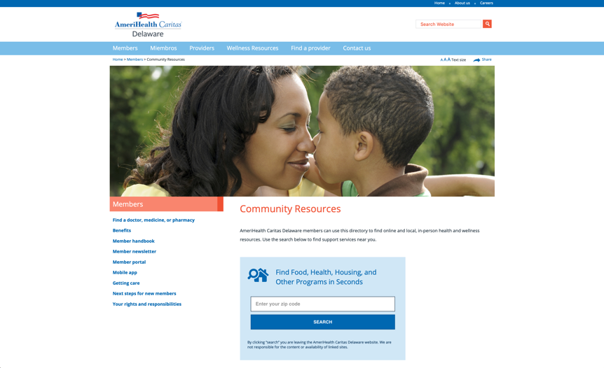
Wellness Resources
Need help? Visit AmeriHealth Caritas Delaware’s community wellness
resource directory.
Visit www.amerihealthcaritasde.com
and click on the Wellness Resources
link. You do not need a password or
login information.

Slide 44
Wellness Resources (continued)
The wellness resources directory
includes resources for:
Behavioral health.
Disease management.
Education and training.
Exercise.
Family care.
Food and nutrition.
Housing and social services.
Medical facilities.
Emergency numbers.
You can search for programs by type of activity, location. You will also find contact information for each program and instructions on how to access them.

Slide 45

Mobile App
Stay updated on your health care
information by downloading our
mobile app to your smartphone.
AmeriHealth Caritas Delaware
mobile app can help you:
Download your ID card.
Select a new doctor or specialist.
Access your medication list.
Get directions to your appointment.
Find the phone number for
AmeriHealth Caritas Delaware.
What to do next:
To get the mobile app, visit the Google
PlayTM store or Apple App Store.® The mobile app is available for iPhone and Android smartphones. Or text “app” to 85886.

Slide 46
State of Delaware Contacts
Health Benefits Manager for Enrollment — 1-800-996-9969.
State of Delaware, Division of Social Services
Customer Relations — 1-800-372-2022.
DHSS Change Report Center — 1-866-843-7212
Services offered:
Member eligibility.
Member enrollment.
Change of name, address, or phone number.
Reporting a birth or income change.
Help in applying for Medicaid.
Checking on an application.

Slide 47

AmeriHealth Caritas Delaware Contacts
Member Services:
  Diamond State Health Plan —
  1-844-211-0966.
  Diamond State Health Plan-Plus —
  1-855-777-6617.
Email — members@amerihealthcaritasde.com
Website — www.amerihealthcaritasde.com
Services offered:
  Help with member inquiries.
  Help with billing issues.
  Disease management.
  Maternity management.
  Care coordination.

Slide 48

Member Advocate
A Member Advocate can assist
you, your health care providers,
and case managers with:
  Obtaining care.
  Scheduling appointments.
  Grievances and appeals.
Call one of these numbers to
speak to a Member Advocate:
  Diamond State Health Plan —
  1-833-669-7674.
  Diamond State Health
  Plan-Plus — 1-833-669-7674.
  Diamond State Health
  Plan-Plus LTSS — 1-855-777-6617.

Slide 49
Stay Connected
Social Media
Follow us on social media to stay updated on current news, health resources and information, and upcoming events.
Facebook: AmeriHealthCaritasDE
Instagram: @AmeriHealthCaritasDE
Upcoming Events:
None scheduled

Slide 50
AmerihealthCaritasDE @AmeriHealthCaritasDE
ACDE_222312350-1

